Slide 1
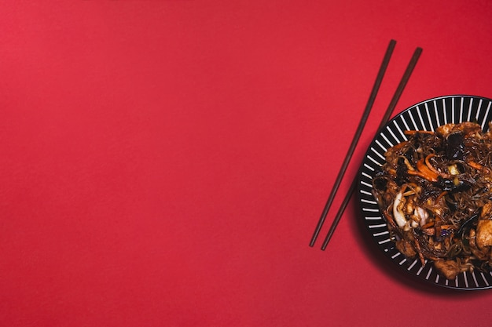
RAFIK’S KITCHEN ANALYSIS REPORT - 2022

Slide 2

Observed KPI’S
Total Revenue - ₹ 9.78M
Total Expenses - ₹ 6.65M
Total Profit - ₹ 3.13M
Profit Margin – 31.97%
Average Revenue Per Day - ₹ 28.34K

Slide 3

Monthly Revenue, Expenses & Profit
MONTH | REVENUE | EXPENSES | PROFIT
JANUARY | ₹ 907k | ₹ 606K | ₹ 301K
FEBUARY | ₹ 844k | ₹ 571K | ₹ 273K
MARCH | ₹ 934K | ₹ 622K | ₹ 312K
APRIL | ₹ 465K | ₹ 300K | ₹ 165K
MAY | ₹ 838K | ₹ 569K | ₹ 269K
JUNE | ₹ 853K | ₹ 584K | ₹ 269K
JULY | ₹ 825K | ₹ 566K | ₹ 259K
AUGUST | ₹ 871K | ₹ 589K | ₹ 282K
SEPTEMBER | ₹ 829K | ₹ 567K | ₹ 262K
OCTOBER | ₹ 808K | ₹ 556K | ₹ 252K
NOVEMBER | ₹ 783K | ₹ 554K | ₹ 229K
DECEMBER | ₹ 817K | ₹ 563K | ₹ 253K

Slide 4






PAYMENT MODE OF SALES PERCENT
UPI – 36.34%
CARD – 32.14%
CASH – 31.52%
PERCENTAGE OF VEG & NON-VEG ORDERS
VEG - 31.06 %
NON – VEG – 68.94%

Slide 5

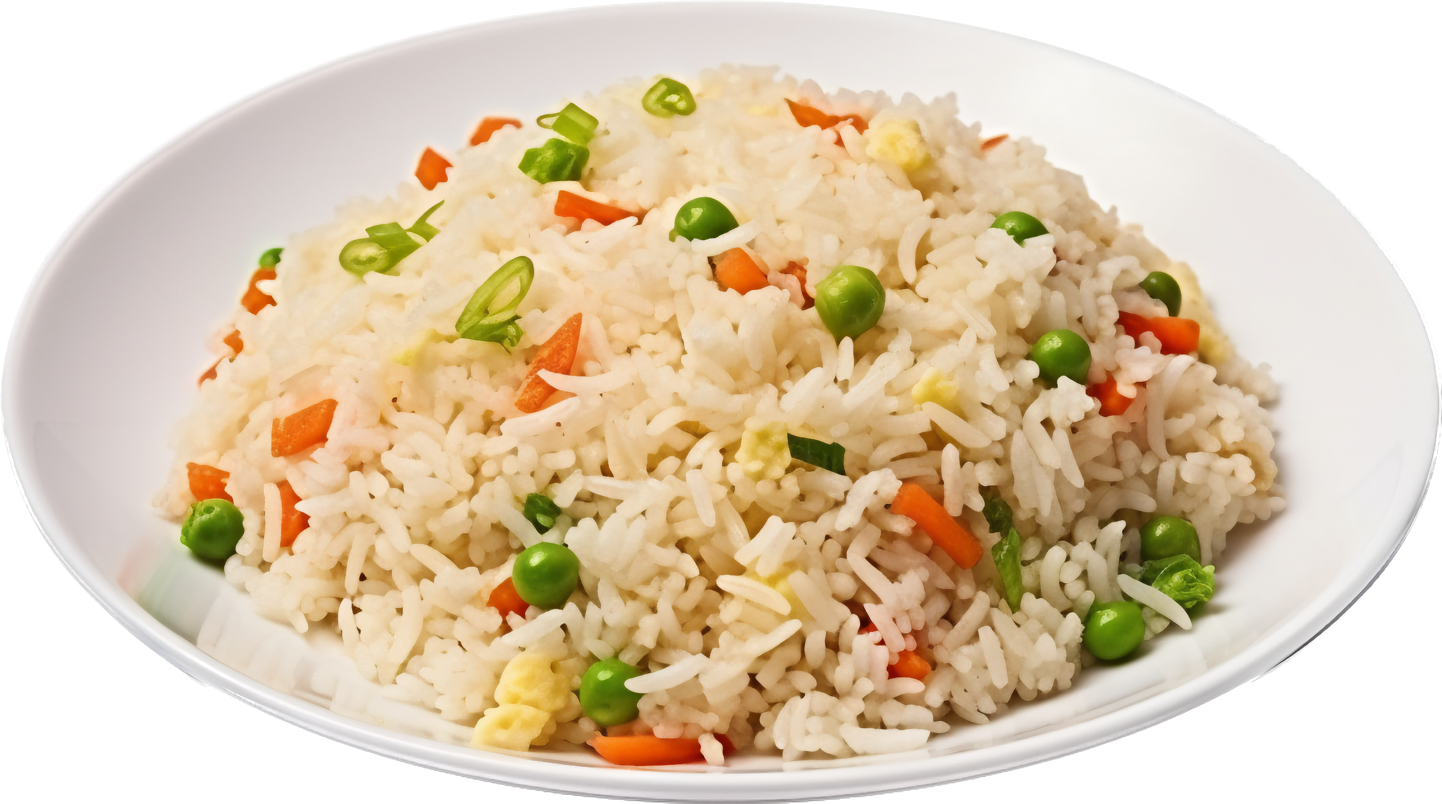
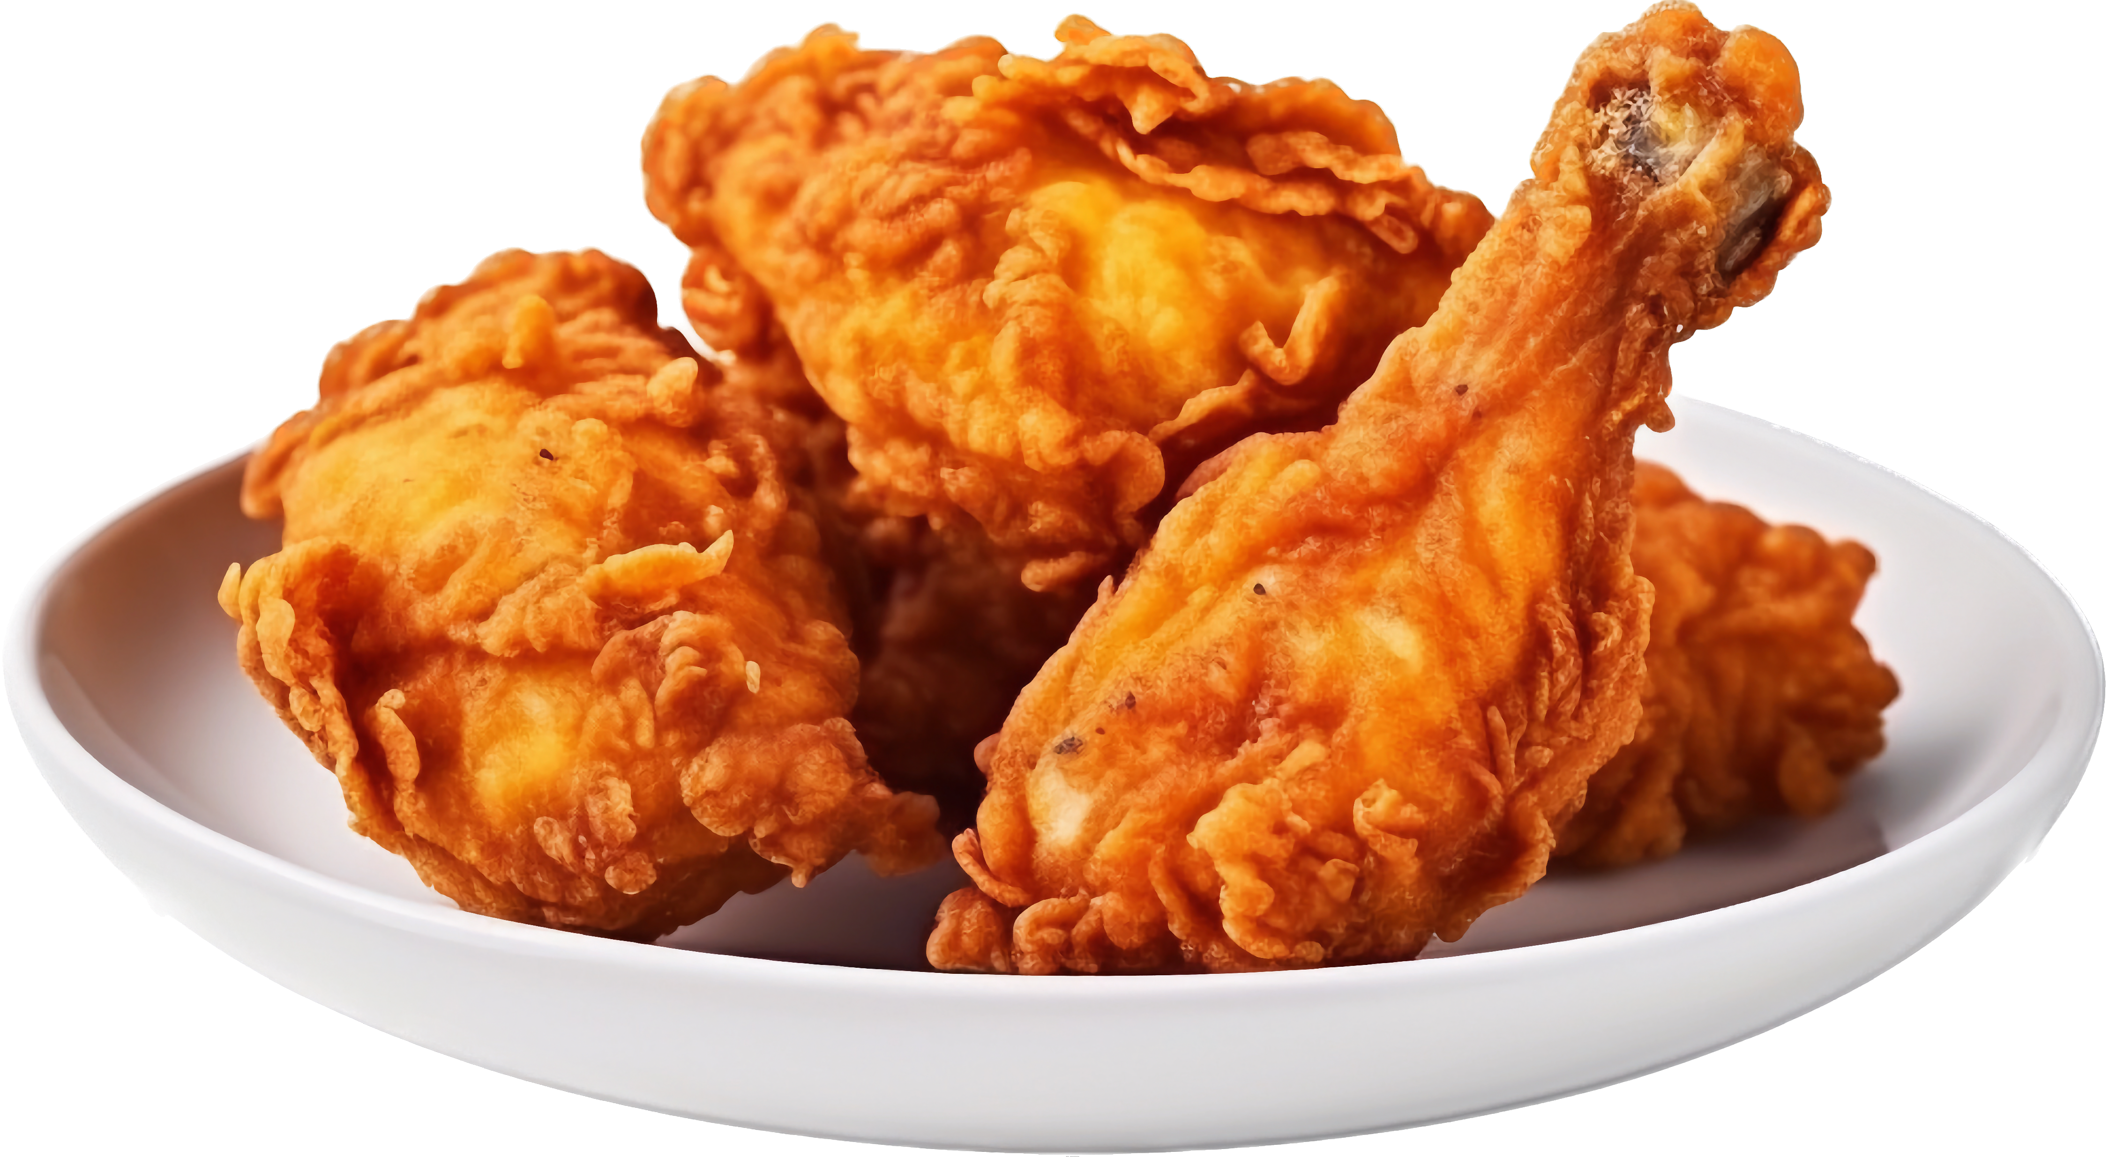
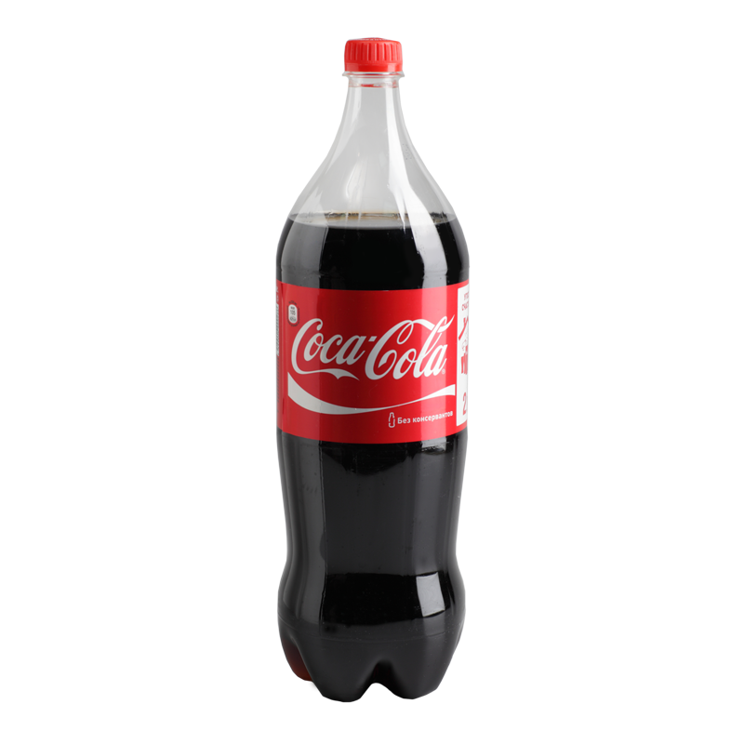


SALES BY CATEGORY
Main Course – 13.55K
Side Dish – 9.22K
Starters – 9K
Soft Drinks – 6.4K

Slide 6

Item–wise Sales with Quantities
Top 5 Best Selling Item
Bottom 5 Worst Selling Items
Chicken Fried Rice – 6872
Chicken Noodles – 6068
Coca Cola – 4682
Pepsi – 4480
Mojito(Blue) - 4344
Grilled Chicken Half (Garlic) – 659
Grilled Chicken Quarter (Pepper) – 629
Grilled Chicken Quarter (mint) – 478
Grilled Chicken Quarter – 439
Grilled Chicken Half (Mint) - 191

Slide 7

Item-Wise Sales Revenue
Top 5 High Revenue Generating Items
Grilled Chicken Full - ₹ 6,88,710
Chicken Fried Rice - ₹ 6,18,,480
Chicken Noodles - ₹ 5,46,300
Grilled Chicken Full (Mint) - ₹ 5,36,750
Grilled Chicken Full (Pepper) - ₹ 5,22,550

Slide 8

Item-Wise Sales Revenue
Bottom 5 Low Revenue Generating Items
Chicken 65 - ₹ 61,600
Grilled Chicken Quarter (Mint) – ₹ 57,360
Egg Chilli Parotta - ₹ 55,350
Grilled Chicken Quarter - ₹ 43,900
Grilled Chicken Half (Mint) - ₹ 38,200

Slide 9

EXPENSES BY CATEGORY
EXPENSES | FINAL AMOUNT
Daily Fresh chicken | ₹ 16,69,619
Indian Stores | ₹ 9,97,481
Salary | ₹ 7,61,020
Ravi Essences | ₹ 6,91,068
Gas | ₹ 5,73,540
Mullai Veggies | ₹ 3,70,875
Reliance Fresh | ₹ 3,38,663
Reshman Mart | ₹ 3,21,135
Ram Plastics | ₹ 2,59,591
C.S Eggs | ₹ 2,19,343
Rent | ₹ 1,80,000
Bake Point | ₹ 1,15,581
EB | ₹ 61,930
Hotel Asha | ₹ 50,534
Global Agro Traders | ₹ 34,500
Misc. Ex | ₹ 7,200
Total | ₹ 66,52,080

Slide 10



INSIGHTS FROM
A2Z DATA PROFESSIONALS SERVICES
E-mail : a2z.dataprofessionals3@gmail.com
Contact : 0452-7961907

